Slide 1


Artificial Intelligence (Machine Learning & Deep Learning)
NAVTTC & Strings Technologies
by Salman Ahmad

Slide 2
Outline Week 10 Day 2
Attention Mechanism
You have to know the past to understand the present — Carl Sagan

Slide 3
Why Attention?
RNNs struggle with long-term dependencies
Encoder–decoder models compress all information into a fixed-size vector
Attention allows the model to focus on relevant parts of the input sequence at each output step
Inspired by human cognitive attention: we don’t process everything equally at once

Slide 4
BUT…
Before Attention Mechanism, It’s Necessary to Understand Encoder-Decoder

Slide 5
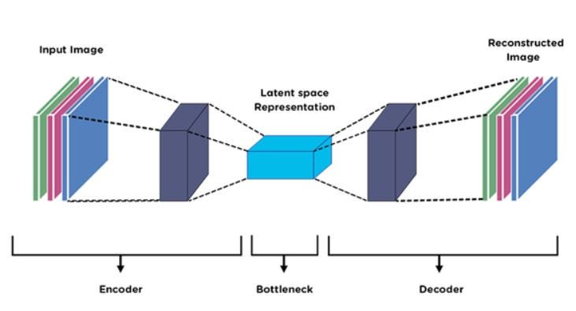
Encoder–Decoder Architecture

Slide 6
Motivation
Many NLP tasks require transforming an input sequence → output sequence
E.g., translation: “I love NLP” → “Ich liebe NLP”
Fixed-size models struggle with variable-length inputs/outputs
Encoder–decoder models solve this by:
Using an encoder to understand the input
Using a decoder to generate the output, step by step

Slide 7
Encoder-Decoder Model
A neural network most widely associated with the transformer architecture
Used in seq-seq learning
Used to handle sequential data, specifically mapping input sequences to output sequences of different lengths
An encoder-decoder network generates variable length output sequence corresponding to an input sequence

Slide 8
Encoder
RNN, LSTM, GRU (or Transformer encoder)
Reads entire input sequence
Produces hidden states:
Last hidden state (traditional)
Sequence of hidden states (for attention)

Slide 9
Decoder
RNN, LSTM, GRU (or Transformer decoder)
Generates the output sequence one token at a time
Uses:
Context from encoder
Its own previous outputs (auto-regressive)

Slide 10
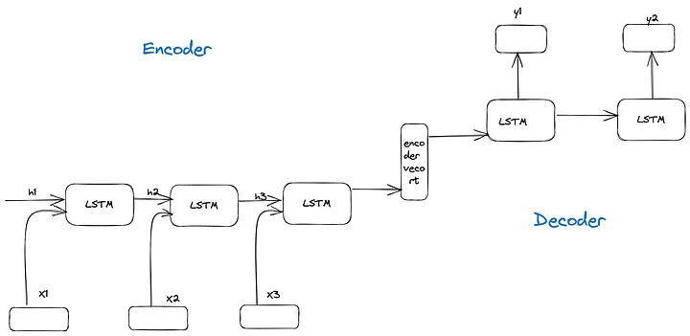
Encoder-Decoder

Slide 11
Key Idea of Attention
For each output, compute a weighted combination of all input hidden states
The weights (attention scores) tell the model how much to focus on each input token
Enables dynamic context instead of fixed vectors
For example, for the sentence “A man has a red flower in his right hand”, attention mechanism assigns trainable weights to the embeddings of input
A | man | has | a | red | flower | in | his | right | hand
0.01 | 0.10 | 0.05 | 0.01 | 0.20 | 0.25 | 0.05 | 0.02 | 0.20 | 0.11

Slide 12
Components of Attention
Let’s say:
Query = decoder hidden state at time t
Keys = encoder hidden states for all input steps
Values = same as keys (usually)
Formulas:
Score: Compute alignment scores between Query q and each Key kᵢ
Common functions: dot-product, additive, scaled dot-product
Weights: Apply softmax over the scores → attention weights αᵢ
Context vector: Weighted sum of Value vectors
score(q, kᵢ) = q · kᵢ\nαᵢ = softmax(score(q, kᵢ))\ncontext = Σ αᵢ * vᵢ

Slide 13
Types of Attention
Global attention: Considers all parts of the input sequence when making predictions.
Local attention: Focuses on a smaller, localized region of the input sequence.
Self-attention: Allows the model to relate different positions within the same input sequence, enabling it to capture complex relationships.

Slide 14
Transformer Attention: Self-Attention
Each token attends to every other token (including itself)
Computes multiple parallel attention heads
Basis of models like BERT and GPT
Attention(Q, K, V) = softmax( (QKᵀ) / √dₖ ) · V

Slide 15
Summary
Attention is a mechanism to dynamically focus on relevant input
Replaces the bottleneck of fixed context vectors in RNNs
Essential in modern architectures (e.g., Transformers)
Improves performance in NLP, vision, and beyond

Slide 16

Questions?
"He who asks a question is a fool for a minute; he who does not remains a fool forever." – Confucius

